Slide 1

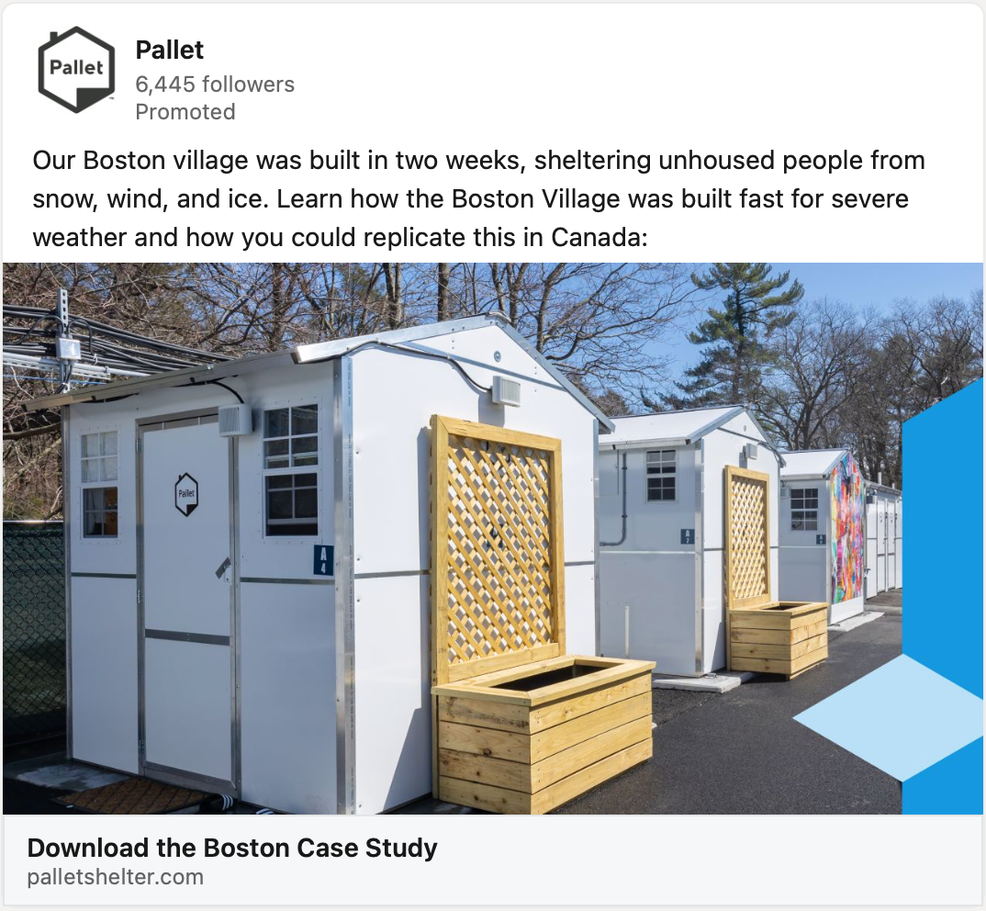
Paid Ads Support
Client Overview
Pallet aims to end the human displacement crisis with rapid-response shelter products and give people a fair chance at employment.
Affirma Support & Outcomes
Pallet’s marketing vendor unexpectedly closed shop and they needed a new partner to step in and support demand and lead gen efforts, particularly paid ads.
Their primary target audience includes government agencies and local municipalities. Affirma supports with:
LinkedIn Ads
279% increase in leads with 71% decrease in cost per lead since taking over!
Google Search Ads
Bing Ads – launched Dec 2024 as net new channel
Lead Management and marketing processes
Strategic advisement and best practices
Marketing technology admin and email nurtures
“Affirma is a fantastic partner! Their flexibility and varied expertise filled key gaps in our team, helping us build a solid marketing foundation. They quickly understood our brand, truly listened to our needs, and are a pure joy to work with.”
- Karen Predmore, Creative Director | Pallet

Slide 2
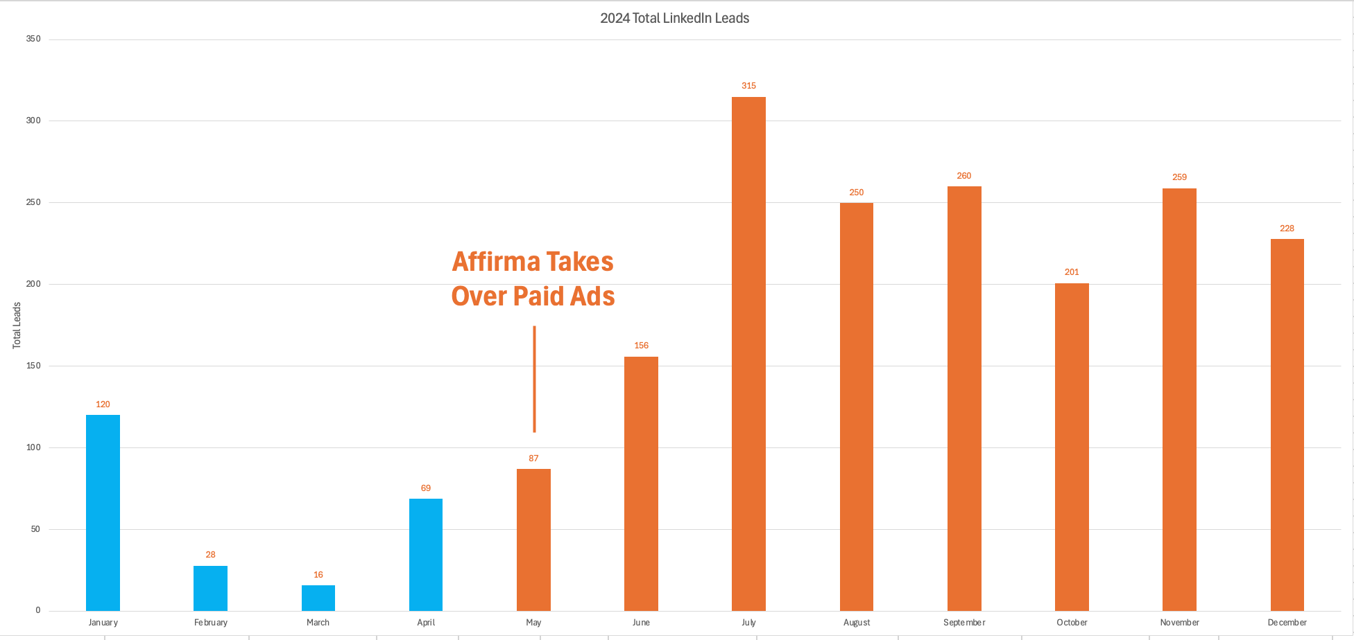

Historical LinkedIn Lead Data (2024) – Total Leads
58 leads/month avg
220 MQL leads/month avg (279% increase)

Slide 3
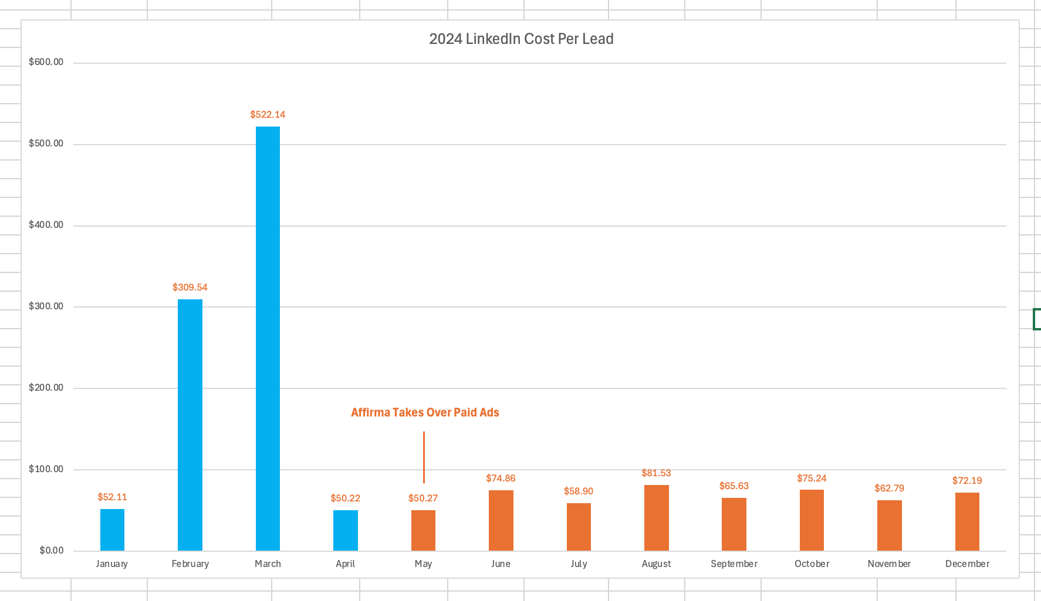
Historical LinkedIn Lead Data (2024) – Cost Per Lead
Avg CPL $234
Avg CPL $68 (71% decrease)

